Slide 1

H.A.L. Astronomy School

Slide 2

Here Comes Saturn!
Observing Saturn in Prime Time, or
Where Do We Get the Name Saturday?, or
The Real Lord of the Rings

Slide 3
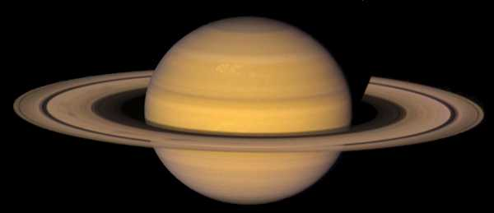
Notes:
This, of course, Saturn as you’ll never see it through the apertures of amateur-sized telescopes. It is, however, graphic evidence of why it is the Lord of the Rings currently. Quite naturally, if you teach yourself to think in terms of long time, and as an astronomer you really must, Saturn’s ring system is only temporary. It is not the only planet to ever have one. It just happens to be the most stupendous ring system we know of in our lifetimes.
Let’s remind ourselves of the scale of things: SIZE AND SHAPE Saturn is about 74,898 miles (120,536 km) in diameter (at the equator at the cloud tops). This is about 9.4 times the diameter of the Earth. 764 Earths could fit inside a hollowed-out Saturn. Saturn is the most oblate (flattened) planet in our Solar System. It has a equatorial diameter of 74,898 miles (120,536 km) (at the cloud tops) and a polar diameter of 67,560 miles (108,728 km). This is a difference of about 10%. Saturn's flattened shape is probably caused by its fast rotation and its gaseous composition.

Slide 4
Saturn
The View Through the Telescope
Notes:
More important, perhaps, unless you control the Hubble Space Telescope, is the view through your own telescope. We enter now the world of the attainable from Carr’s Mill, for example.

Slide 5
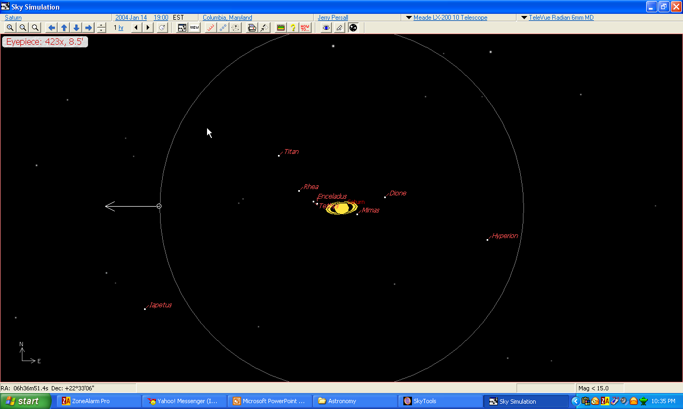
Notes:
This is a very good approximation of Saturn through most amateur telescopes if you will take the power up to 400x+. This particular view is how it looks through my TeleVue NP-101 with my TeleVue 6mm Radian eyepiece. The field of view here is 8.5’. This is last night from anywhere any of us would view Saturn locally. You can see accurate ring tilt. And you can see the little dots of light that are the 8 telescopically visible moons of Saturn. Notice that the moons of Saturn do not splay themselves out in a straight line like the moons of Jupiter do. Notice there are twice as many moons to identify and account for than the four Jovian satellites. Just like the moons of Jupiter, however, the moons of Saturn move around nightly and each night you observe them they will appear arrayed in a new pattern.

Slide 6

Notes:
Here, for example, they are 24 hours later. This is how they are arrayed right now.

Slide 7
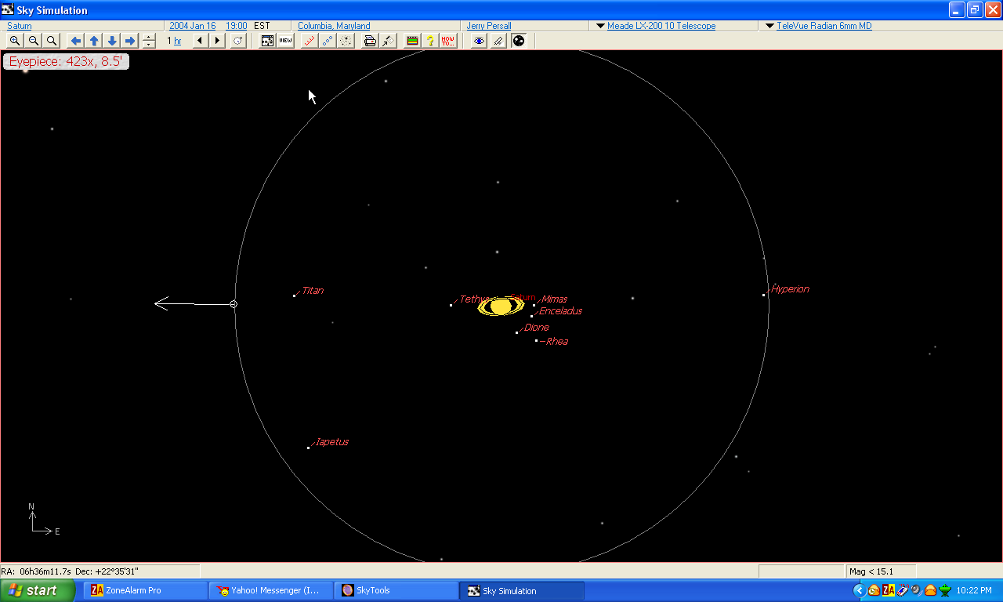
Notes:
And this is how they will be arrayed tomorrow night at the same time. They move night after night and you do need a scorecard to follow the game correctly. I’ll tell you where to get several of them for free in a moment.

Slide 8
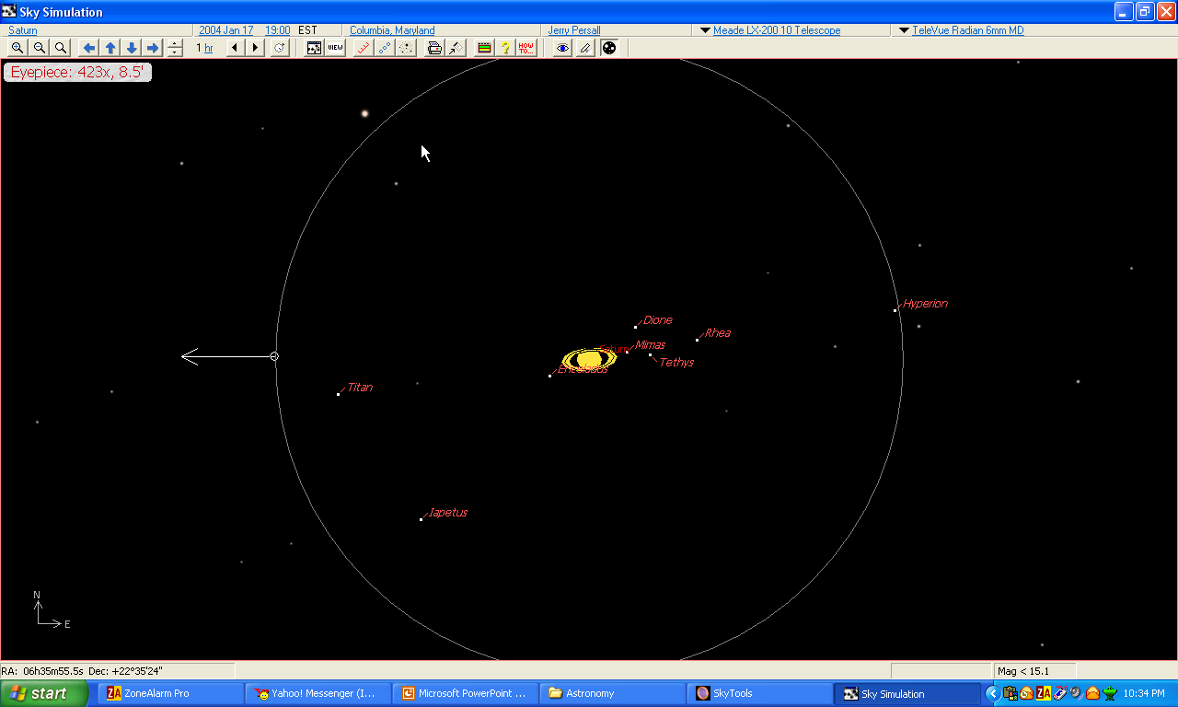
Notes:
Here is the array for this Saturday night. If you are going to observe Saturn with any degree of discipline you will need to know the array of the moons before you look through the eyepiece. There movements can be traced night after night but their movements can also be traced nightly, just as you can follow the movements of Jupiter’s moons during a single night’s observing session. Let’s go back to tonight’s view.

Slide 9

Notes:
This is tonight. Right now. If we were beginning an observing session tonight we might want to take a peek at Saturn and its moons and make a note of their individual positions. We don not have to wait, however, until tomorrow night to see the movements in effect. We canb go about our other observing business and come back to check on Saturn at the end of our session. To see what I mean here is Saturn and its moons one hour from now.

Slide 10


Slide 11

Notes:
It is 2100 hours EST now.

Slide 12

Notes:
This is 2200 EST.

Slide 13

Notes:
And this is 2300 EST. I’m going to go all the way back to 1900 hours and fast forward quickly now. Each new view is one hour later than the previous one.

Slide 14
Notes:
Here is the array for this Saturday night. If you are going to observe Saturn with any degree of discipline you will need to know the array of the moons before you look through the eyepiece. There movements can be traced night after night but their movements can also be traced nightly, just as you can follow the movements of Jupiter’s moons during a single night’s observing session. Let’s go back to tonight’s view.

Slide 15
Notes:
And here is the eyepiece view one hour from then.

Slide 16
Notes:
It is 2100 hours EST now.

Slide 17
Notes:
This is 2200 EST.

Slide 18
Notes:
And this is 2300 EST.

Slide 19
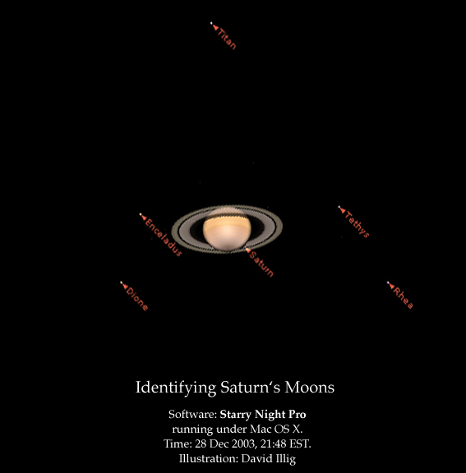
Notes:
There are any number of websites and software programs that will help you identify Saturn’s moons. Thanks to David Illig for the next sequence of slides showing some of these alternatives. Here, for example, is Starry Night Pro.

Slide 20
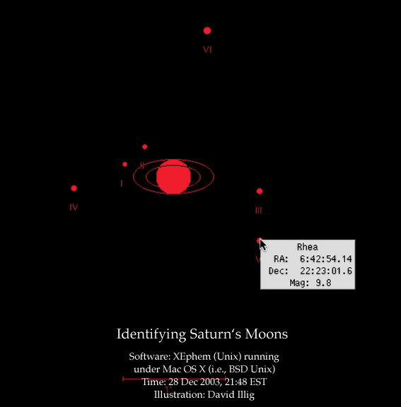
Notes:
And here is XEphem running in Linux.

Slide 21
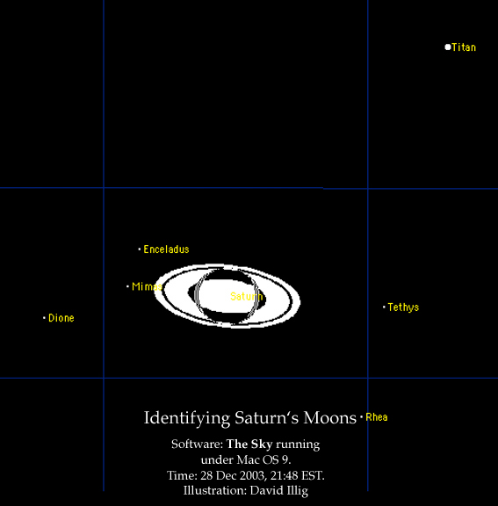
Notes:
Here is TheSky running in a Mac.

Slide 22
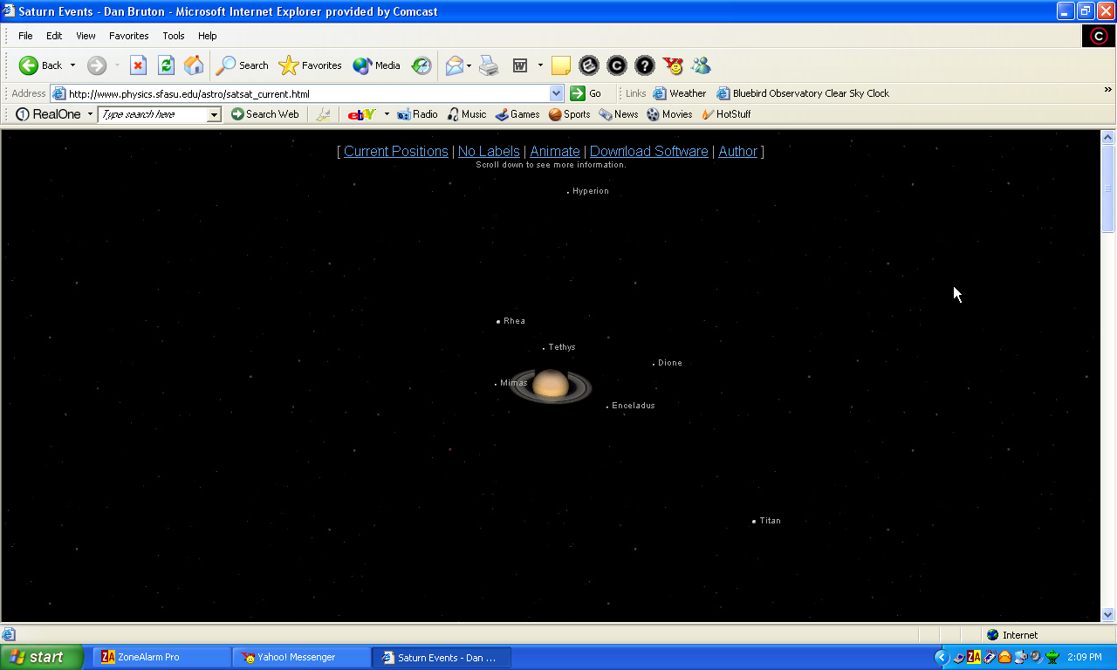
www.physics.sfasu.edu/astro/saturn.html
Notes:
Graphics-wise, this one is the very nicest. It is brilliantlky executed piece of astronomy software. Unfortunately, you cannot download it and so you can only check it as a reference and do a printscreen to take to the telescope.

Slide 23
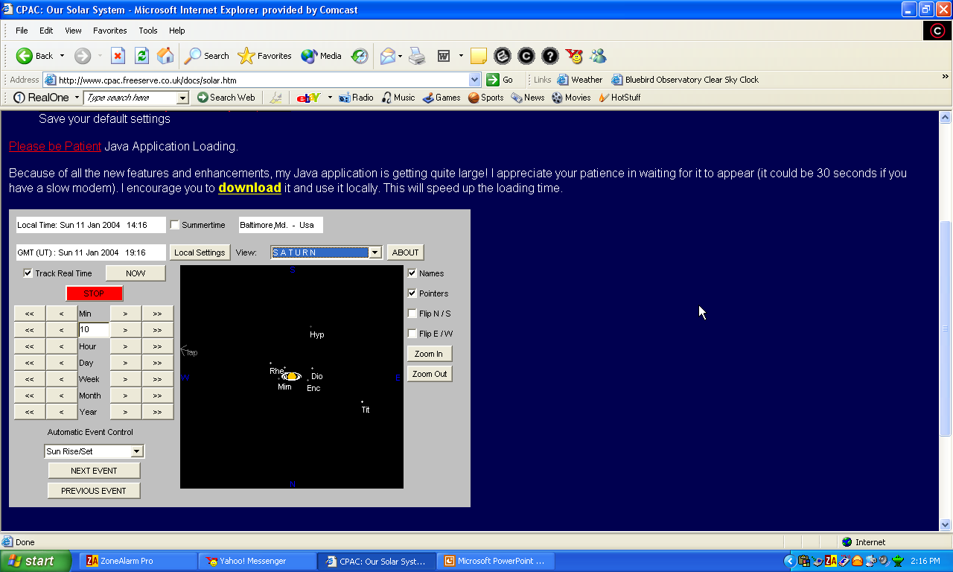
The Planets (Version 2.02) FREE at www.cpac.freeserve.co.uk/docs/solar.htm
Notes:
This one is almost as good and even has more versatility since it covers the entire solar system. It is FREE and it does a very nice job on Saturn’s ring position and orbiting satellites. Highly recommended.

Slide 24
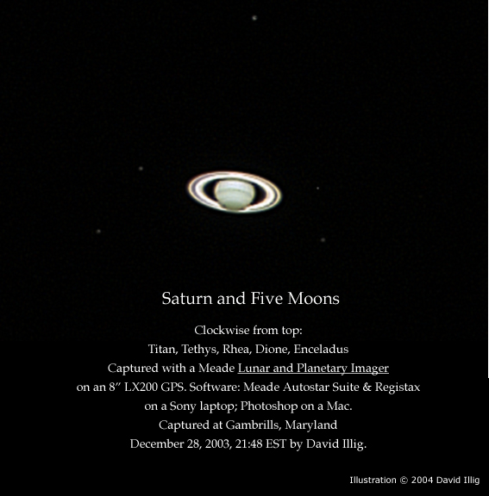
Notes:
And here is the real thing. Look closely and you can see five of Saturn’s satellites taken with Meade imaging apparatus by David Illig just over two weeks ago.

Slide 25
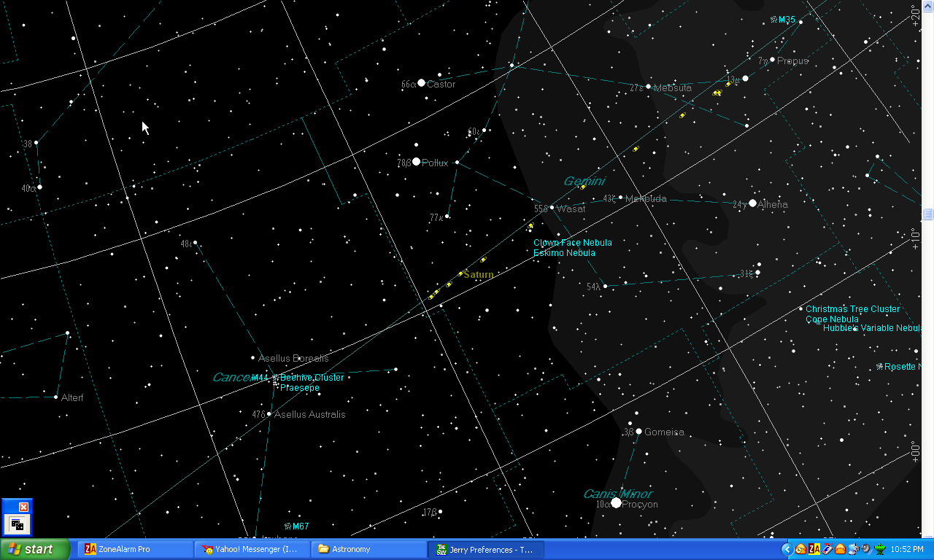
Notes:
Because the dance of the planets is slow and majestic, particularly the outer gas giants, you will not have any difficulty in knowing hiw to find Saturn in the next year. It will ALWAYS be in Gemini. This hopefully goes a long way towards correcting a popular misconception. You do not have to wonder where the large planets are every night you go out to observe. Tbey are, essentially, right where you left them last night, last week, last month, or, in some cases, last year. It takes Saturn 29.46y to orbit the sun. Call it 30y if it is easier to remember. There are 360 sky degrees around the ecliptic. Saturn takes a full year, on average, to traverse 12 sky degrees. Here is Saturn’s path in Gemini for the next 12 lunations, not months. Each Saturn graphic is separated in time by 29.5 days, or one lunation. The dance of the planets is predictable, and majestic.

Slide 26
The Ring System
Knowing your A, B, C’s…

Slide 27
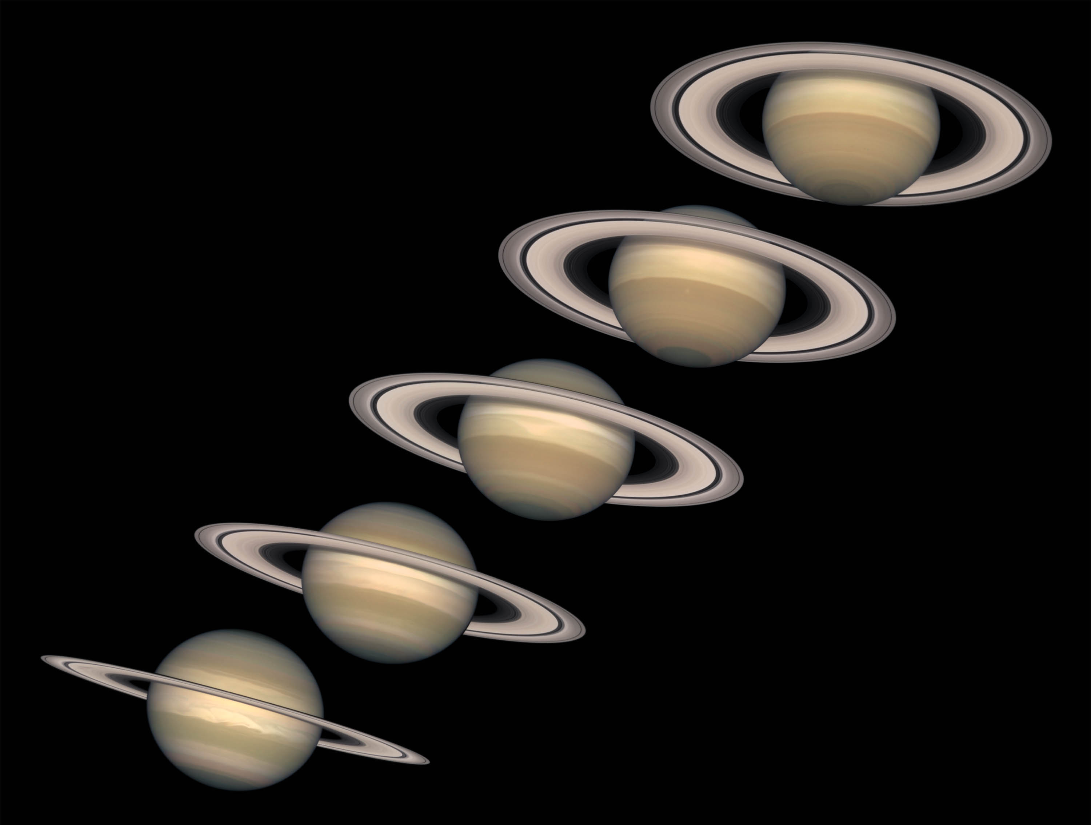
Notes:
Looming like a giant flying saucer in our outer solar system, Saturn puts on a show as the planet and its magnificent ring system nod majestically over the course of its 29-year journey around the Sun. These Hubble Space Telescope images, captured from 1996 to 2000, show Saturn's rings open up from just past edge-on to nearly fully open as it moves from autumn towards winter in its Northern Hemisphere.
Saturn's equator is tilted relative to its orbit by 27 degrees, very similar to the 23-degree tilt of the Earth. As Saturn moves along its orbit, first one hemisphere, then the other is tilted towards the Sun. This cyclical change causes seasons on Saturn, just as the changing orientation of Earth's tilt causes seasons on our planet. The first image in this sequence, on the lower left, was taken soon after the autumnal equinox in Saturn's Northern Hemisphere (which is the same as the spring equinox in its Southern Hemisphere). By the final image in the sequence, on the upper right, the tilt is nearing its extreme, or winter solstice in the Northern Hemisphere (summer solstice in the Southern Hemisphere).

Slide 28
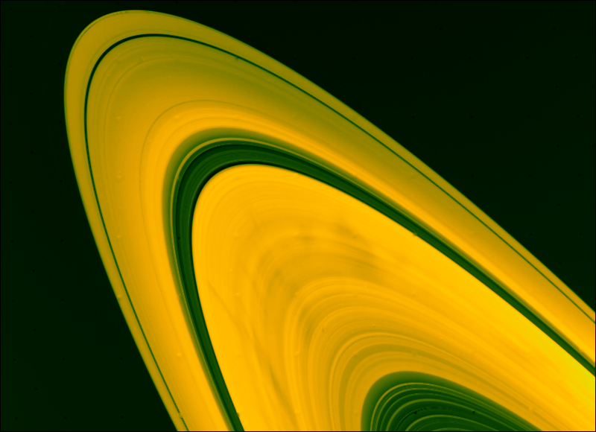
Notes:
The rings are divided into 7 major ring divisions. There are two main sections (called rings A and B) plus the smaller ring (Ring C or the Crepe ring), D and F rings; the larger gap in the rings is called the Cassini division; the smaller one is the Encke division. Starting closest to Saturn, the rings and divisions are: D, C, B, The Cassini Division, A, the Encke division, and F (subdivided into G and E, and a ring with visible clumps of matter, called knots). The short version of the story is, from outside in, A, B, and C. The A ring will have Encke’s Division; the large gap between the A ring and the B ring is CAssini’s Division; the tenuous C ring is rarely seen.
Saturn's moon Prometheus and Pandora, shepherding Saturn's narrow, outer F Ring.The rings show intricate structure; some of this structure is from the gravitational effect of shepherding moons, but much about these rings is unknown.
Saturn's bright rings are made of ice chunks and rocks that range in size from the size of a fingernail to the size of a car. Although the rings are very extremely wide (almost 185,000 miles = 300,000 km in diameter), they are very thin (about 0.6 miles = 1 km thick).

Slide 29
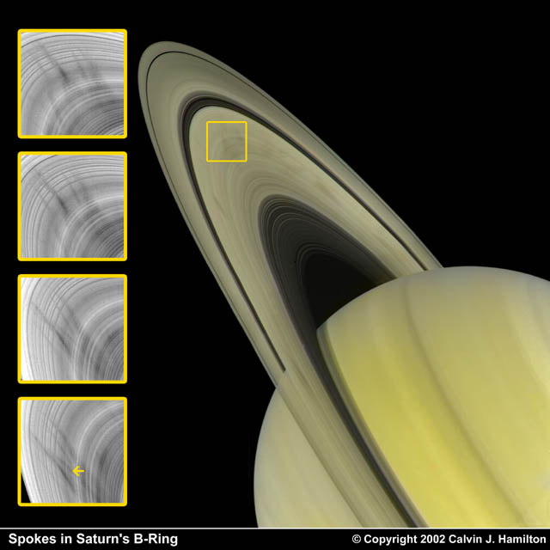
Notes:
One of the curious discoveries made by the Voyager spacecraft was the presence of dark radial features that move in curious patterns on the B ring. These features have been named spokes due to their likeness of spokes on a wheel.
This picture shows a 35 minute sequence (top to bottom) of the change in spoke appearence. It also shows the swift formation of a new, radially aligned spoke (see arrow in the bottom image).
Spokes are thought to be microscopic dust particles that have levitated away from the ring plane. They appear on both sides, near the densest part of the B ring. They rotate at the same rate as Saturn's magnetic field indicating they are affected by electromagnetic forces. They form about 104,000 kilometers from Saturn's center and extend out to the Cassini division. They are shapped somewhat like an hour glass with the narrow centers located near the synchronous orbit radius. Perhaps they are formed by meteorites that punch through the rings, by tiny moonlets as they plunge through the rings, or dust particles that have taken on a charge and levitated off the larger ring bodies

Slide 30
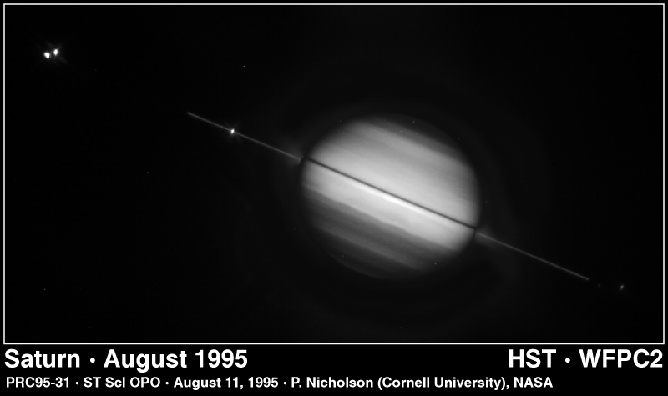
Notes:
Saturn's magnificent ring system is seen tilted edge-on -- for the second time this year -- in this NASA Hubble Space Telescope picture taken on August 10, 1995, when the planet was 895 million miles (1,440 million kilometers) away. Hubble snapped the image as Earth sped back across Saturn's ring plane to the sunlit side of the rings. Last May 22, Earth dipped below the ring plane, giving observers a brief look at the backlit side of the rings. Ring-plane crossing events occur approximately every 15 years. Earthbound observers won't have as good a view until the year 2038. Several of Saturn's icy moons are visible as tiny starlike objects in or near the ring plane. They are from left to right, Enceladus, Tethys, Dione and Mimas. "The Hubble data shows numerous faint satellites close to the bright rings, but it will take a couple of months to precisely identify them," according to Steve Larson (University of Arizona). During the May ring plane crossing, Hubble detected two, and possibly four, new moons orbiting Saturn. These new observations also provide a better view of the faint E ring, "to help determine the size of particles and whether they will pose a collision hazard to the Cassini spacecraft," said Larson. The picture was taken with Hubble's Wide Field Planetary Camera 2 in wide field mode. This image is a composite view, where a long exposure of the faint rings has been combined with a shorter exposure of Saturn's disk to bring out more detail. When viewed edge-on, the rings are so dim they almost disappear because they are very thin -- probably less than a mile thick.
Credit: Phil Nicholson (Cornell University) and NASA

Slide 31
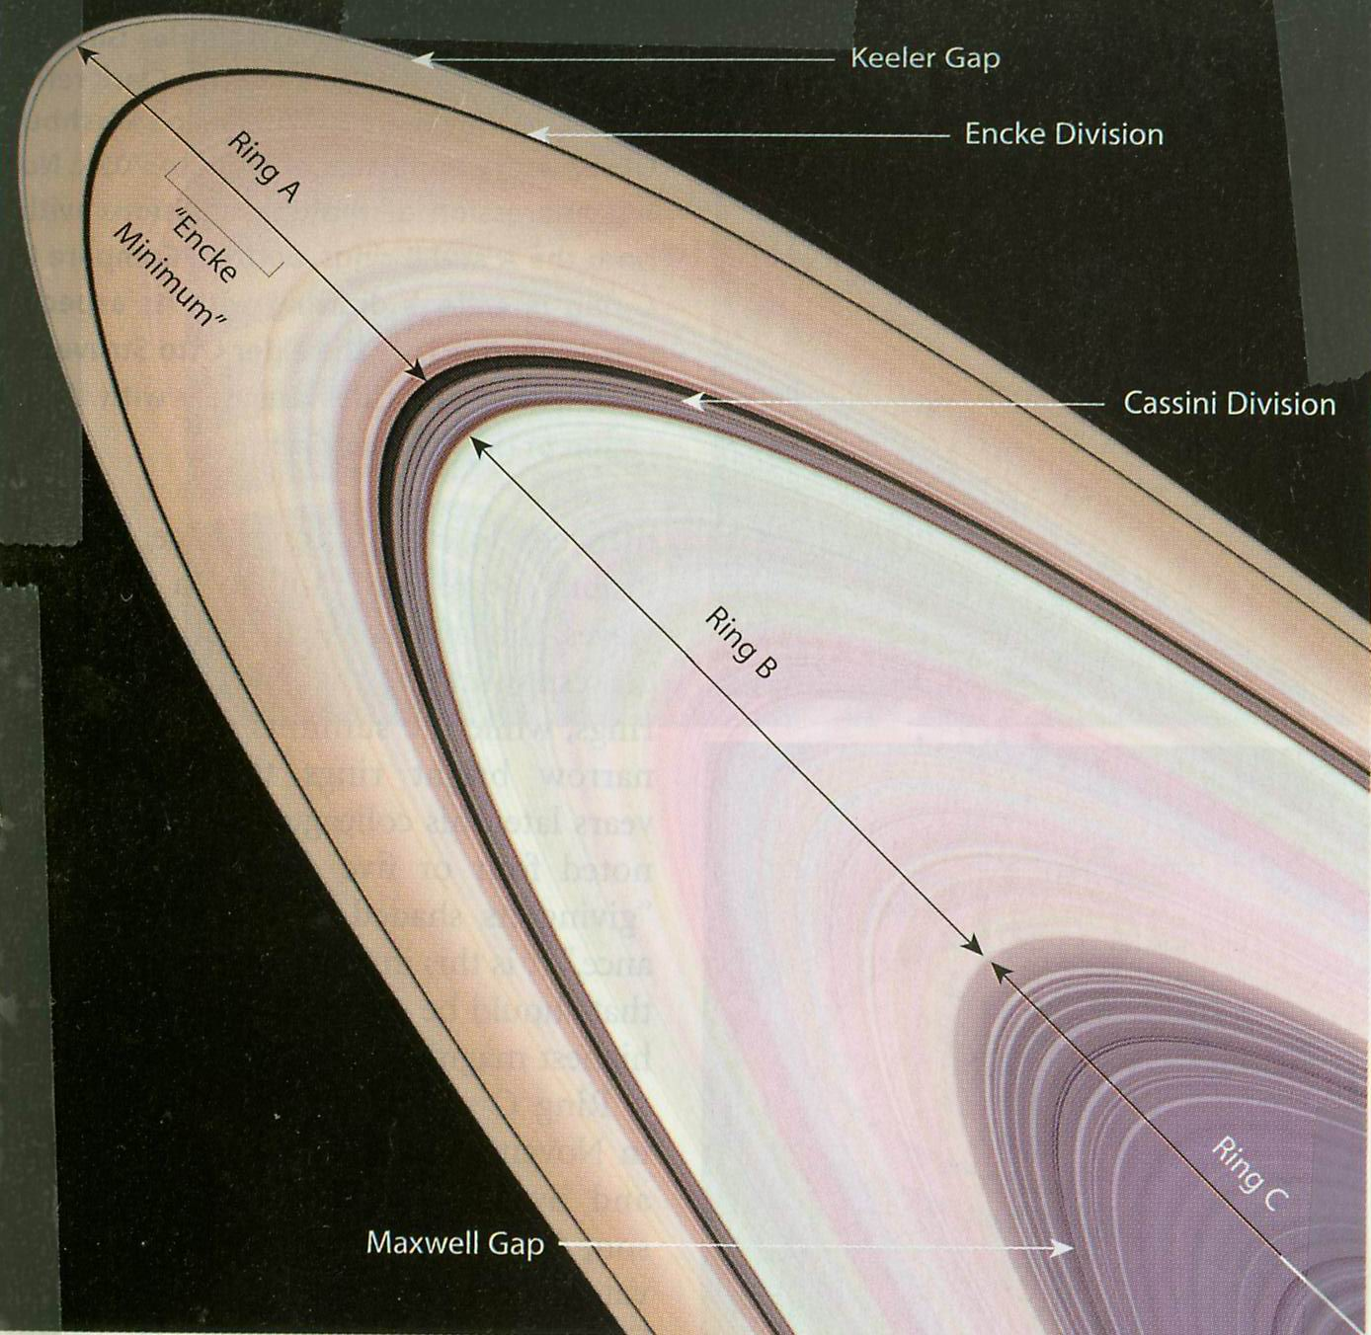
Notes:
Here is the simplified story showing the A, B, and C rings. Notice the Keeler Gap and the Encke Minimum in Ring A. Notice the Cassini Division outside of Ring B. Notice the very tenuous Ring C and the Maxwell Gap.

Slide 32
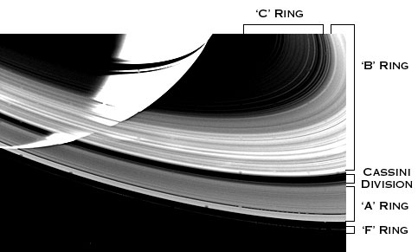
Notes:
Here is yet another illustration showing the same ring features.

Slide 33
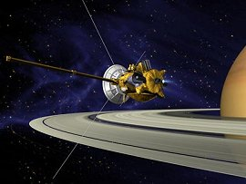
Notes:
We’ll know more when Cassini arrives at Saturn this July bearing my name and my mother’s name.

Slide 34
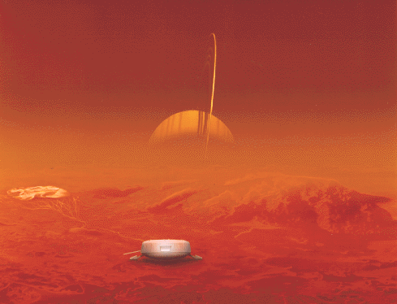
Notes:
The Cassini spacecraft, launched on October 15, 1997, is on its way to Saturn. After reaching Saturn, Cassini will drop a probe into the atmosphere of Titan in December 2004. The probe is pictured on the surface of Titan in the artist's rendition below; Saturn is seen in the background, through the smoggy haze of Titan's atmosphere.

Slide 35
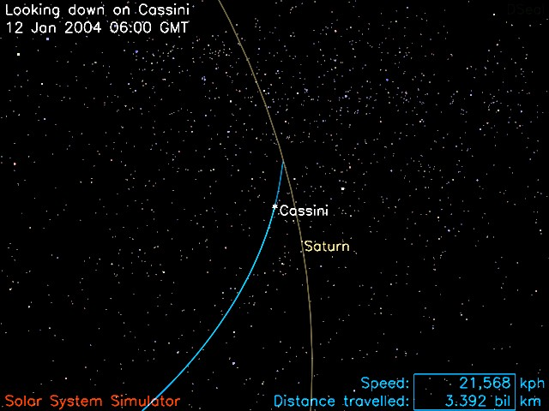
Notes:
Here is where Cassini was last week on January 12. It is bearing in on the point in space where Saturn will be this summer.

Slide 36
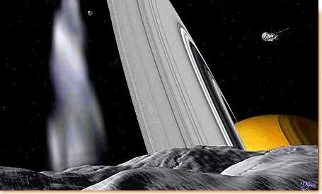
Notes:
Saturn's ring system is seen from the surface of one of the "shepherd" satellites that, through the force of gravity, help guide the ring particles. The Cassini spacecraft is shown in the upper right of this artist's rendering.

Slide 37
Saturn’s Satellites

Slide 38
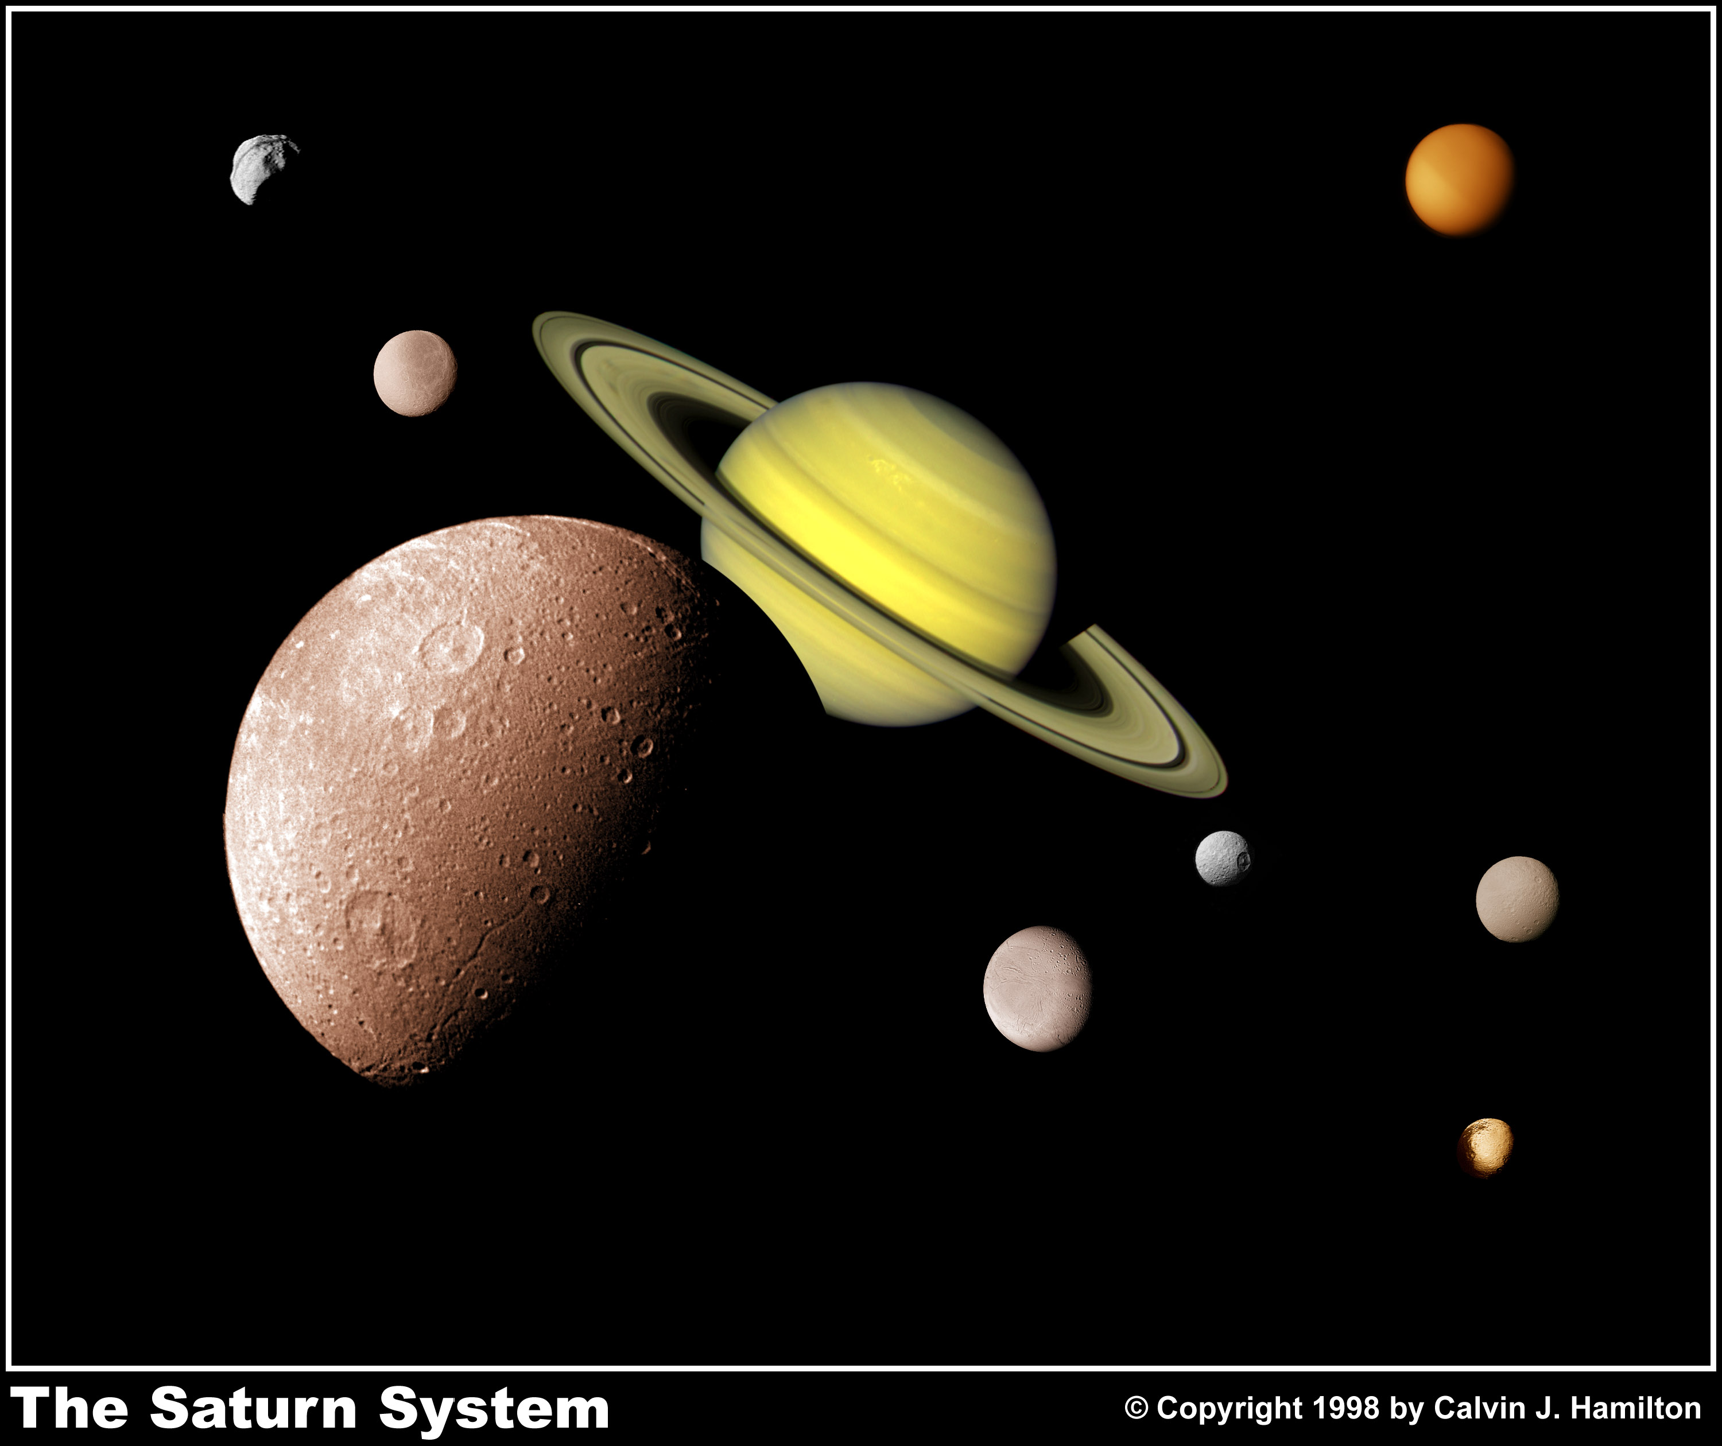
Notes:
This picture of the Saturnian system was prepared from an assemblage of images taken by the Voyager 1 spacecraft during its Saturn encounter in November 1980. This view shows Dione in the forefront, Saturn rising behind, Epimetheus (top-left) and Rhea just to the left of Saturn's rings. To the right and below Saturn's rings are Enceladus, Mimas, Tethys, and Iapetus (bottom-right). The cloud covered Titan is at the top-right.

Slide 39
30 named satellites plus one discovered in 2003 and not yet named
Of those moons for which rotation rates are known, all but Phoebe and Hyperion rotate synchronously

Slide 40
The three pairs Mimas-Tethys, Enceladus-Dione and Titan-Hyperion interact gravitationally in such a way as to maintain stable relationships between their orbits: the period of Mimas' orbit is exactly half that of Tethys, they are thus said to be in a 1:2 resonance; Enceladus-Dione are also 1:2; Titan-Hyperion are in a 3:4 resonance.

Slide 41
Distance Radius Mass
Satellite (000 km) (km) (kg) Discoverer Date
--------- -------- ------ ------- ---------- -----
Pan 134 10 ? Showalter 1990
Atlas 138 14 ? Terrile 1980
Prometheus 139 46 2.70e17 Collins 1980
Pandora 142 46 2.20e17 Collins 1980
Epimetheus 151 57 5.60e17 Walker 1980
Janus 151 89 2.01e18 Dollfus 1966
Mimas 186 196 3.80e19 Herschel 1789
Enceladus 238 260 8.40e19 Herschel 1789
Tethys 295 530 7.55e20 Cassini 1684
Telesto 295 15 ? Reitsema 1980
Calypso 295 13 ? Pascu 1980
Dione 377 560 1.05e21 Cassini 1684
Helene 377 16 ? Laques 1980
Rhea 527 765 2.49e21 Cassini 1672
Titan 1222 2575 1.35e23 Huygens 1655
Hyperion 1481 143 1.77e19 Bond 1848
Iapetus 3561 730 1.88e21 Cassini 1671
Phoebe 12952 110 4.00e18 Pickering 1898

Slide 42
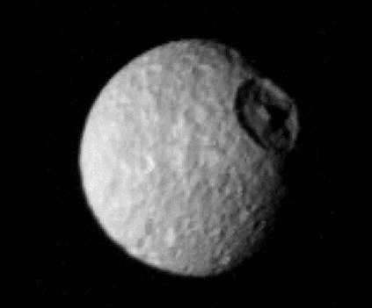
Mimas (“My mas”)
Notes:
Mimas has a huge crater occupying nearly a third of the satellite’s diameter.

Slide 43
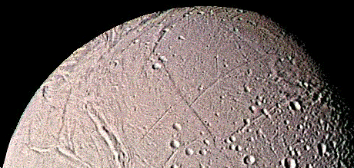
Enceladus (“en SEL a dus”)
Notes:
The surface of Enceladus has a combination of smooth, fractured and cratered terrain.

Slide 44
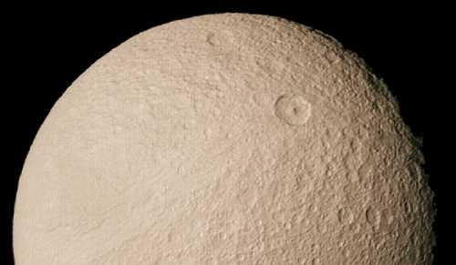
Tethys (“TEE this”
Notes:
Tethys and upcoming Dione have nearly the same diameters.

Slide 45
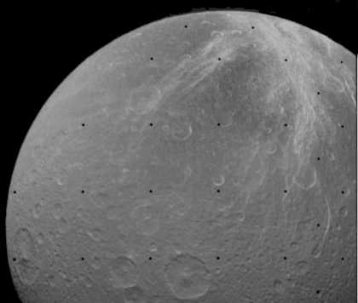
Dione (“dy OH nee”
Notes:
But Dione is a little denser.

Slide 46
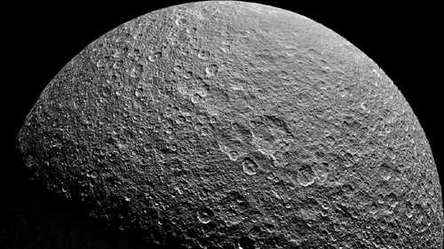
Rhea (“REE a”)
Notes:
Rhea has an old, heavily-cratered surface.

Slide 47
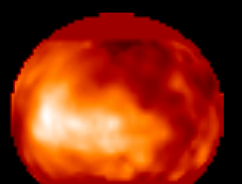
Titan
Notes:
Titan overwhelmingly dominates the Saturnian satellite system and it is the only moon in the entire solar system with a dense atmosphere.

Slide 48
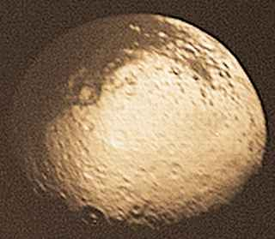
Iapetus (“eye AP i tus”)
Notes:
Iapetus is unusual in that its leading hemisphere is dark, while the trailing hemisphere is nearly five times as bright.

Slide 49
Belts, Zones, and Storm Systems
Saturn’s Surface Features: Sound Familiar?
Notes:
Saturn is not unique in that it has differential rotation. The equatorial region rotates in 10h 14m 00s while much of the remainder of the globe rotates in 10h 38m 25s.

Slide 50
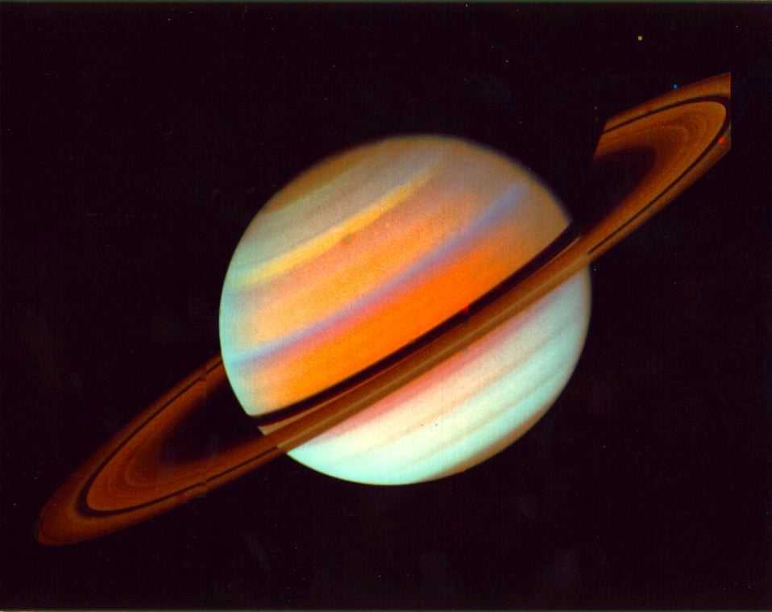
Notes:
The striped cloud bands on Saturn, like Jupiter, are divided into belts and zones.
In a belt, the wind flows very strongly in one direction only. In a zone, the wind flows very strongly in exactly the opposite direction. These kinds of winds are called "zonal winds".

Slide 51
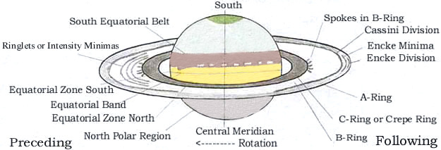

Slide 52
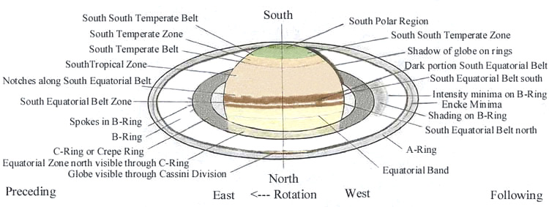

Slide 53
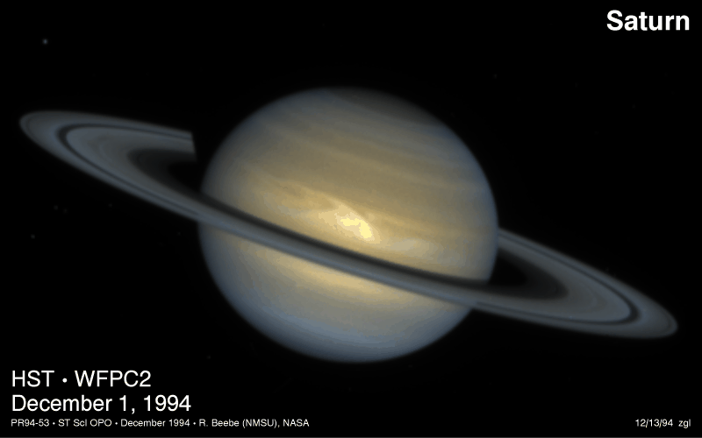
Notes:
This NASA Hubble Space Telescope image of the ringed planet Saturn shows a rare storm that appears as a white arrowhead-shaped feature near the planet's equator. The storm is generated by an upwelling of warmer air, similar to a terrestrial thunderhead. The east-west extent of this storm is equal to the diameter of the Earth (about 7,900 miles). Hubble provides new details about the effects of Saturn's prevailing winds on the storm. The new image shows that the storm's motion and size have changed little since its discovery in September, 1994.
The storm was imaged with Hubble's Wide Field Planetary Camera 2 (WFPC2) in the wide field mode on December 1, 1994, when Saturn was 904 million miles from the Earth. The picture is a composite of images taken through different color filters within a 6 minute interval to create a "true-color" rendition of the planet. The blue fringe on the right limb of the planet is an artifact of image processing used to compensate for the rotation of the planet between exposures.
The Hubble images are sharp enough to reveal that Saturn's prevailing winds shape a dark "wedge" that eats into the western (left) side of the bright central cloud. The planet's strongest eastward winds (clocked at 1,000 miles per hour from analysis of Voyager spacecraft images taken in 1980-81) are at the latitude of the wedge.
To the north of this arrowhead-shaped feature, the winds decrease so that the storm center is moving eastward relative to the local flow. The clouds expanding north of the storm are swept westward by the winds at higher latitudes. The strong winds near the latitude of the dark wedge blow over the northern part of the storm, creating a secondary disturbance that generates the faint white clouds to the east (right) of the storm center.
The storm's white clouds are ammonia ice crystals that form when an upward flow of warmer gases shoves its way through Saturn's frigid cloud tops. This current storm is larger than the white clouds associated with minor storms that have been reported more frequently as bright cloud features.
Hubble observed a similar, though larger, storm in September 1990, which was one of three major Saturn storms seen over the past two centuries. Although these events were separated by about 57 years (approximately 2 Saturnian years) there is yet no explanation why they apparently follow a cycle -- occurring when it is summer in Saturn's northern hemisphere.
Credit: Reta Beebe (New Mexico State University), D. Gilmore, L. Bergeron (STScI), and NASA

Slide 54
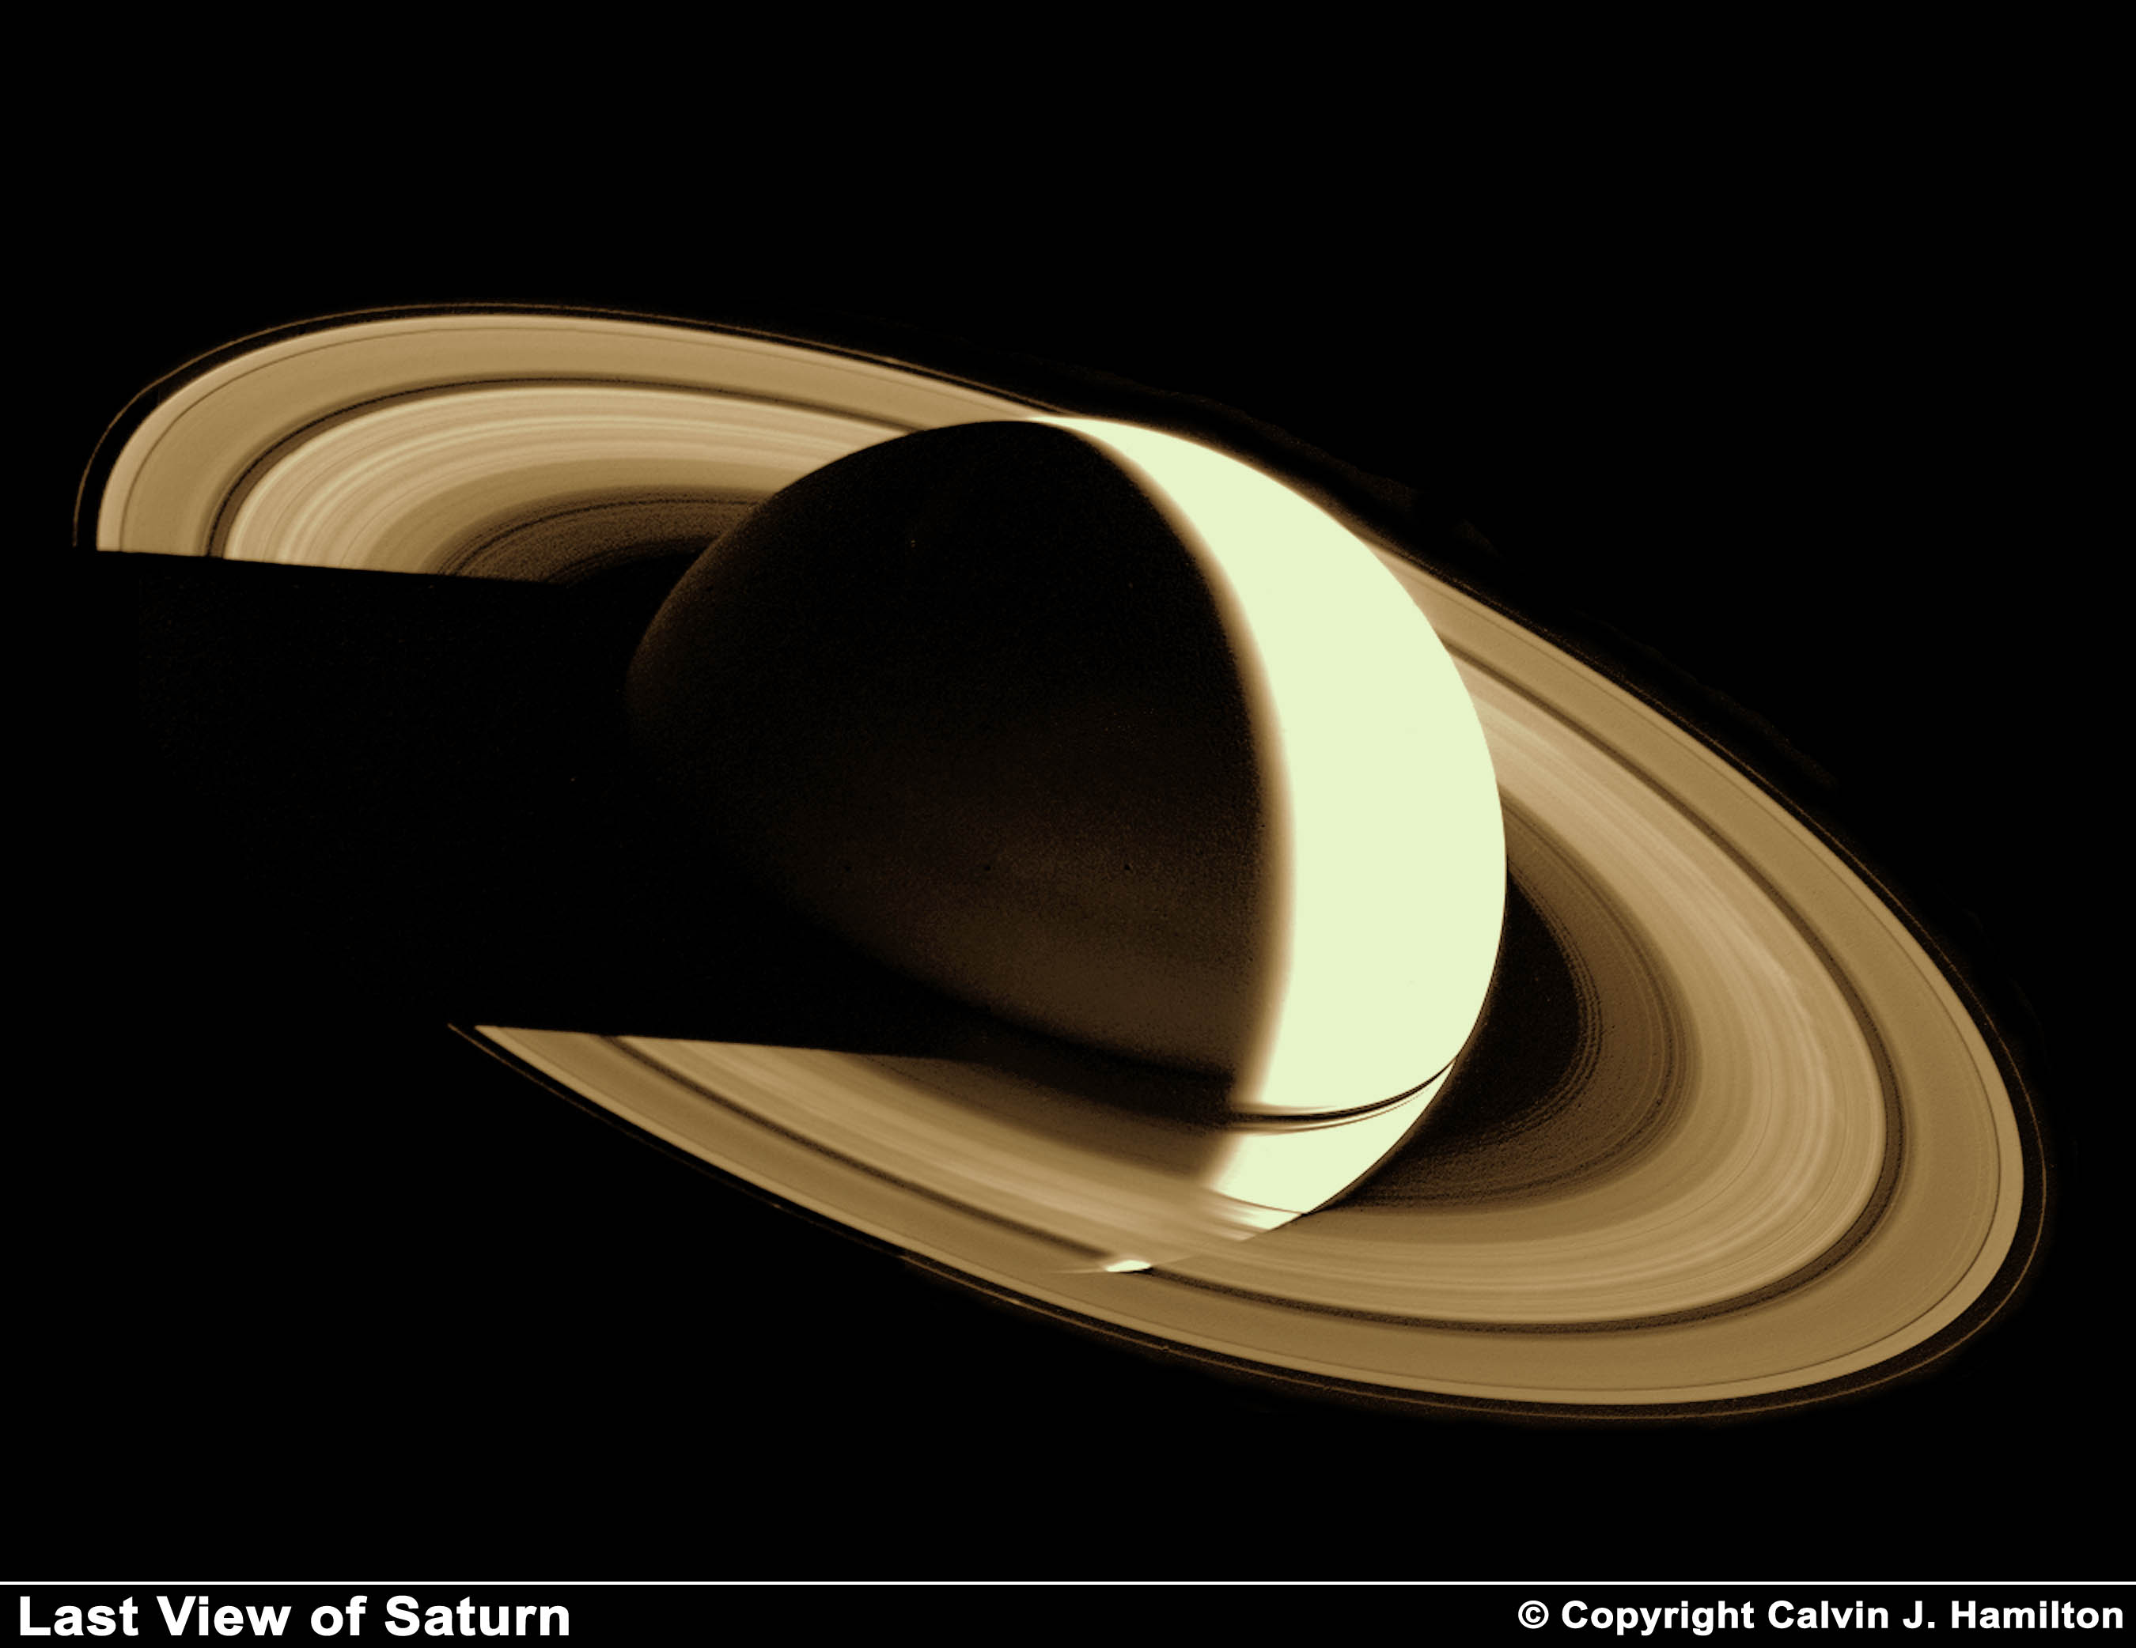
Notes:
Two days after its encounter with Saturn, Voyager 1 looked back on the planet from a distance of more than 5 million kilometers (3 million miles). This view of Saturn has never been seen by an earth based telescope, since the earth is so close to the Sun only the sunlit face of Saturn can be seen.
This image is Copyright © 2002 by Calvin J. Hamilton. Any commercial/for-profit use of this image needs to be addressed to Calvin J. Hamilton

Slide 55
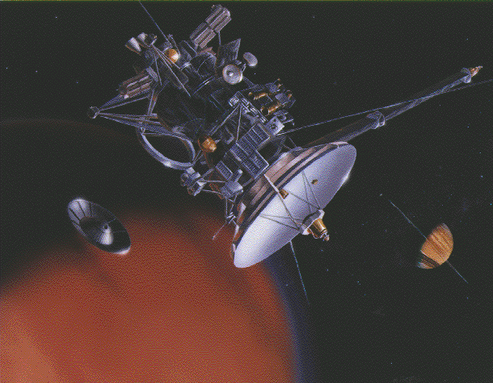
Notes:
This artist's rendering depicts the NASA/JPL Cassini spacecraft in orbit around ringed Saturn (lower right background). At the lower left, the European Space Agency's Huygens probe descends to the surface of Saturn's moon Titan (in foreground).

Slide 56
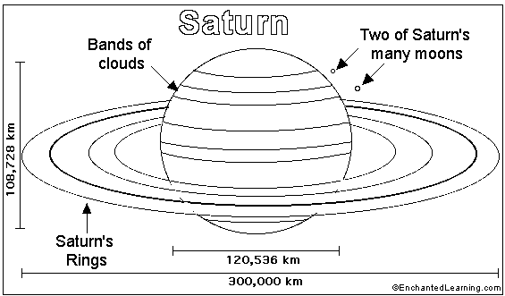

Slide 57
